Slide 1
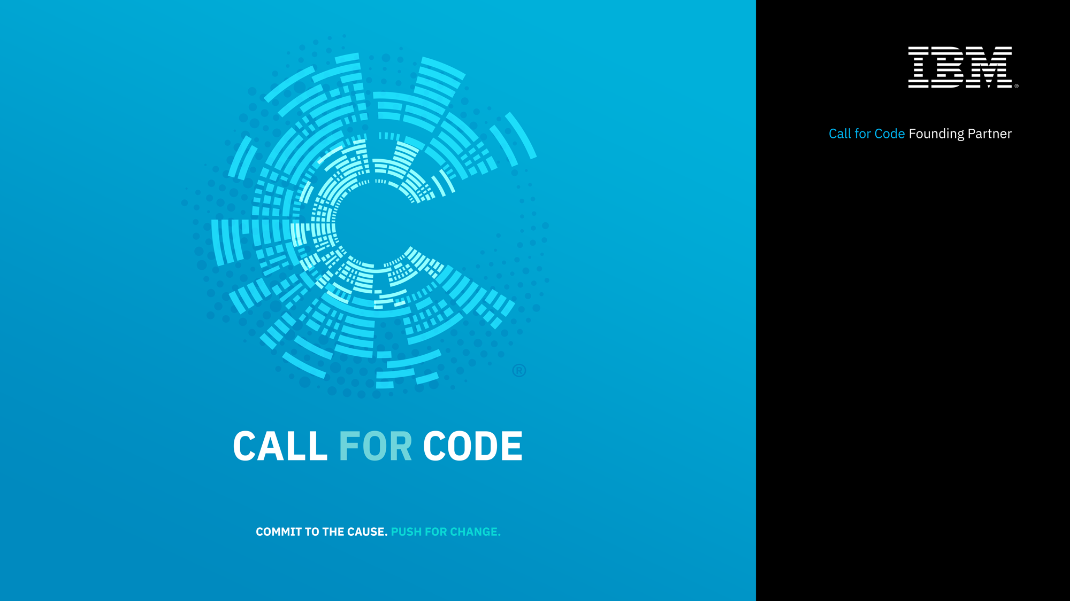

Slide 2
CALL FOR CODE DAY – Workshop Agenda
Kickoff
Disaster Management – Experience story
Coding for a cause
Call For Code Registration
Technology Outlook – Cloud , AI and IoT Services
Lunch
Solution to Problems
Application architecture flow based on IoT, Weather, Blockchain , AI
Demo
Hands-On
Ideation

Slide 3
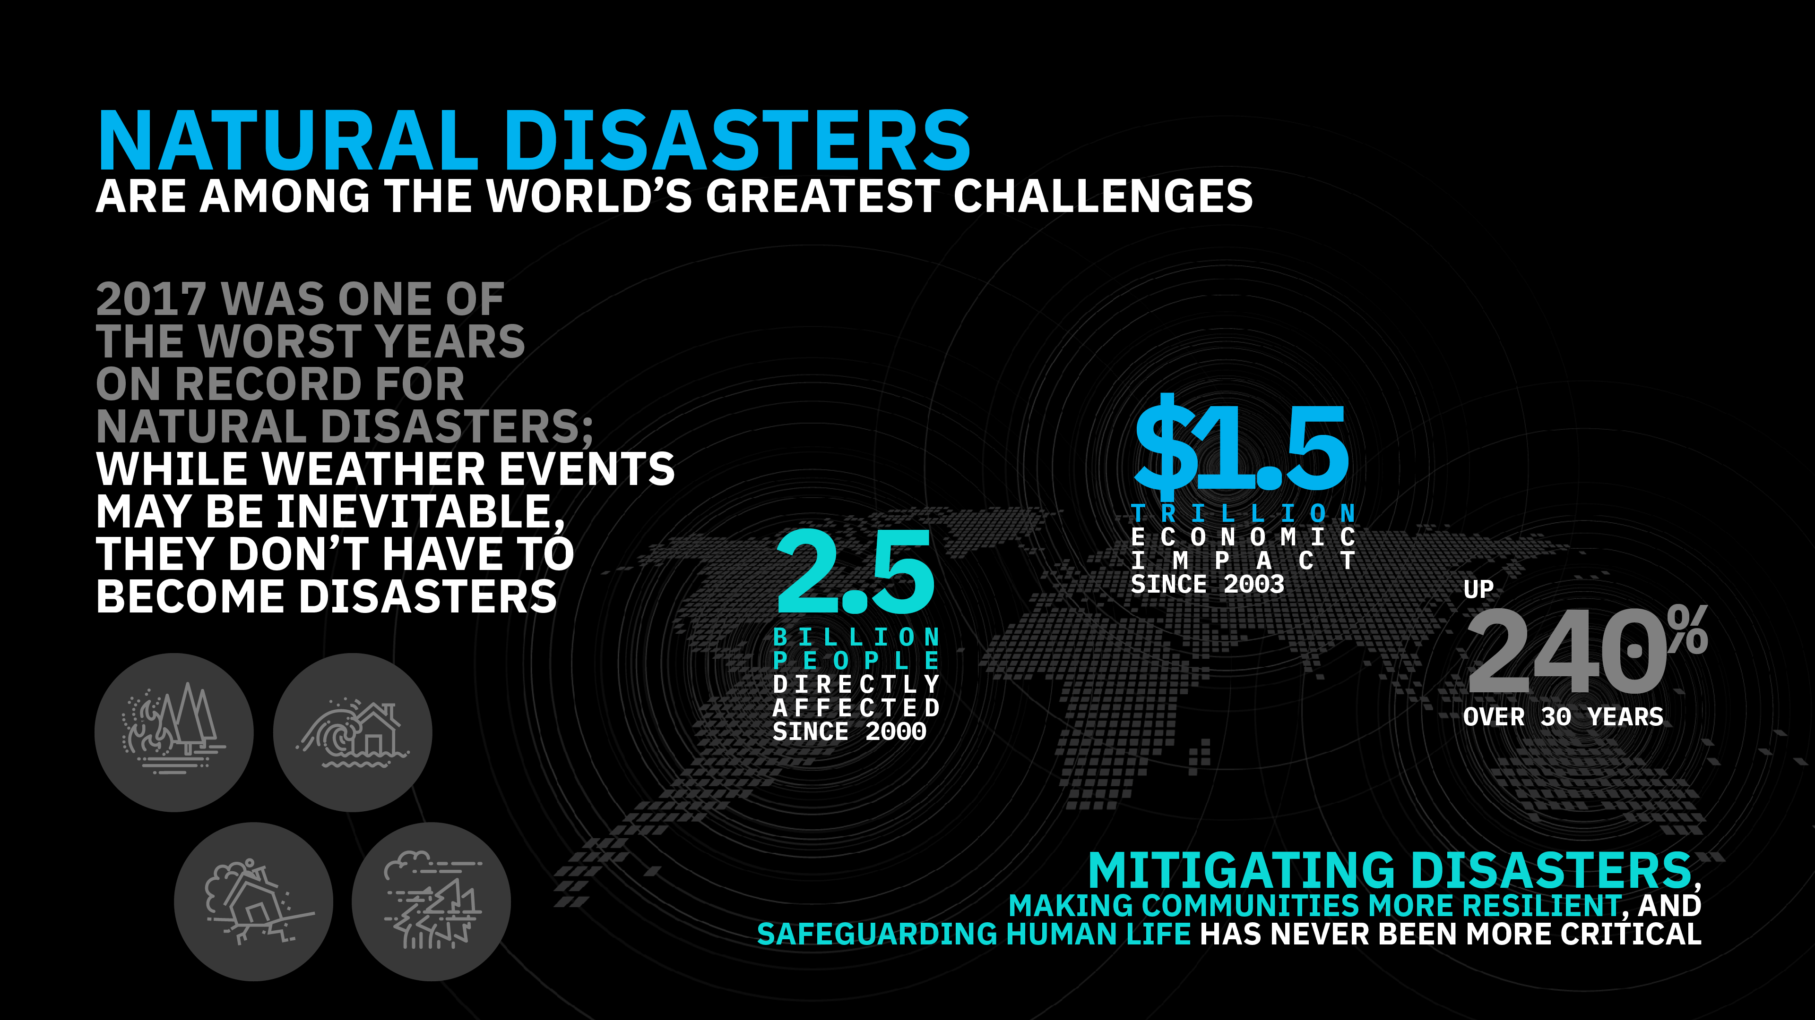
Notes:
Through our long history of working with the world’s developers, particularly in the open source community, we know their impact as the builders of modern business. We also know, through our long history of leading the industry to leverage technology for societal good, that developers can have a similar impact as the builders of a better society – both in ethical considerations for how technology is built and more directly in the use of their skills to address some of the most pressing problems of our modern world.
Caused by Movement of earth : occur with the minimum amount of warning and include earthquakes, volcanic eruptions and tsunamis. They are difficult to predict and impossible to stop. All that can be done is to take appropriate action to limit damage and loss of life after they occur.
Weather related disasters: hurricanes, tornadoes, extreme heat and extreme cold weather.
Floods, mudslides, landslides and famine. Badrinath Landslide ( Uttarakhand ) May 20, 2017 - Nearly 14,000 pilgrims were left stranded at various places in Chamoli district after a massive landslide

Slide 4
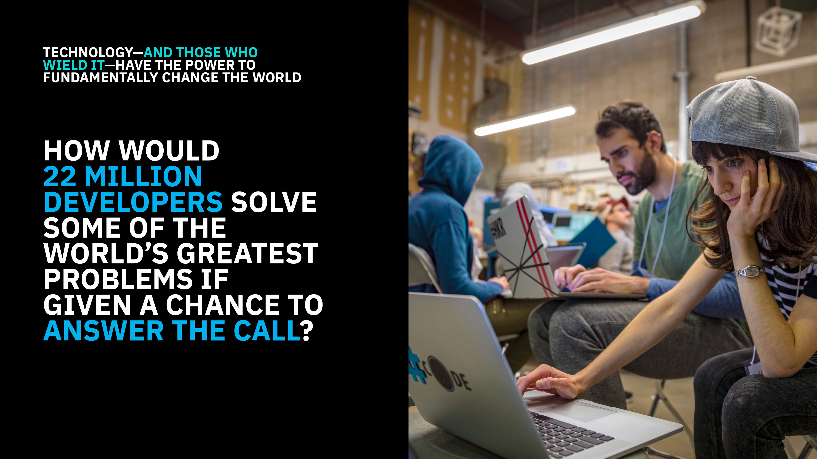

Slide 5
Technology Meets Disaster
New tools make urgent communication among individuals accessible and effective
“Thanks to the opportunities presented by new technologies, we are seeing another stage of emergency management. This new stage balances the historical approach to emergency management with the potential of technology to unify resources and adapt plans in real time.” - Business Insider
IT plays a crucial role in hospitals, such as data management, especially when a tragedy occurs
Assist hospitals to carry out proper and agile care for victims

Slide 6
How Technology can help ?
Hospitals are Smarter with technology
Electronic Health Records
Exchange information on national scale
Limited errors in patients’ data
Cloud-based EHR systems enable hospitals to back up data to different data systems, in case of electricity failing, or flooding becoming too severe
Easy and seamless for hospitals to transport patients to different facilities in order to receive the proper care
Protecting Secure Data is a priority
“Data center and cloud operators based in the Houston area have not reported significant damage to their infrastructure with services continuing to run at sites operated by companies including IBM, Equinix, Level 3 Communications, Data Foundry, CyrusOne and Digital Realty.” - Geek Wire

Slide 7
How Technology can help ?
Predictive analytics helps prepare
“After Hurricane Katrina in 2005, big enterprises like IBM are using predictive analytics to detect storms ahead of time. This helps them determine early response plans.” - Business Insider
Hospitals use the same approach - develop predictive models in order to make sure that facilities are up to date with techniques that will prepare them for emergency situations
Predictive analytics is a form of advanced analytics that uses both new and historical data to forecast future activity, behavior and trends. It involves applying statistical analysis techniques, analytical queries and automated machine learning algorithms to data sets to create predictive models that place a numerical value, or score, on the likelihood of a particular event happening.
Analytic models can predict when the storm is coming, where and how severe it may be

Slide 8
How Technology can help ?
Weather Channel’s visual displays of where the eye of the storm will be, and when ? – through Machine Learning
“The model can deliver damage predictions that are 70 to 80 percent accurate 72 hours before the storm is expected. That gives utilities enough time to arrange to have enough crews to repair the downed lines after the storm has passed through. Getting the forecast in a timely manner is critical to good preparation.” – Datanami
IBM has integrated the power of Analytics & Machine Learning in its services and has even gone a step further, to include population density and soil moisture levels into reports. This gives a good indication about what trees will fall during the storm.
Digital transformation tools such as machine learning not only predicts the storm, but it works to predict the outcome and the effects

Slide 9
How Technology can help ?
Communication - made stronger
Hosting social platforms through digital devices
Geo location is a crucial part of social media platforms, which provides a substantial tool for victims of natural disasters to use
People can simply post about their location, alerting authorities about where help is needed
Telecom companies gear up for disaster and prepare its networks to handle mass amount of data
Project Loon - collaboration between Google and AT&T & T-Mobile, launched helium air balloons to bring internet to Puerto Rico, after Hurricane Maria
Balloons, plus their ground connections, got more than 100,000 people online

Slide 10

Call for Code inspires developers to solve pressing global problems with sustainable software solutions, delivering on their vast potential to do good.
Bringing together NGOs, academic institutions, enterprises, and startup developers to compete build effective disaster mitigation solutions, with a focus on health and well-being.
The American Red Cross, and the United Nations Office of Human Rights combine for the Call for Code Award to elevate the profile of developers.
Award winners will receive long-term support through open source foundations, financial prizes, the opportunity to present their solution to leading VCs, and will deploy their solution through IBM’s Corporate Service Corps.
Developers will jump-start their project with dedicated IBM Code Patterns, combined with optional enterprise technology to build projects over the course of three months.
Judged by the world’s most renowned technologists, the grand prize will be presented in October at an Award Event.

Slide 11
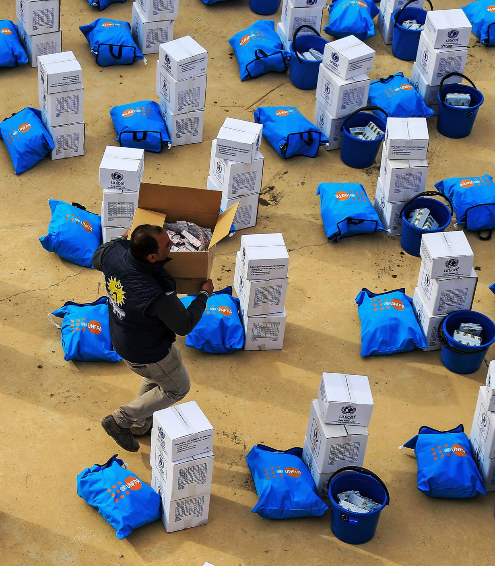
Code Patterns
Build a blockchain network
Deploy an asset-transfer app using blockchain
Create a real-time payments application
Track financial donations with blockchain
Automate business processes via blockchain events
Create financial applications using APIs on mainframe
Build resilient financial networks to execute secure transactions quickly
developer.ibm.com/callforcode/resources/financial-networks/

Slide 12
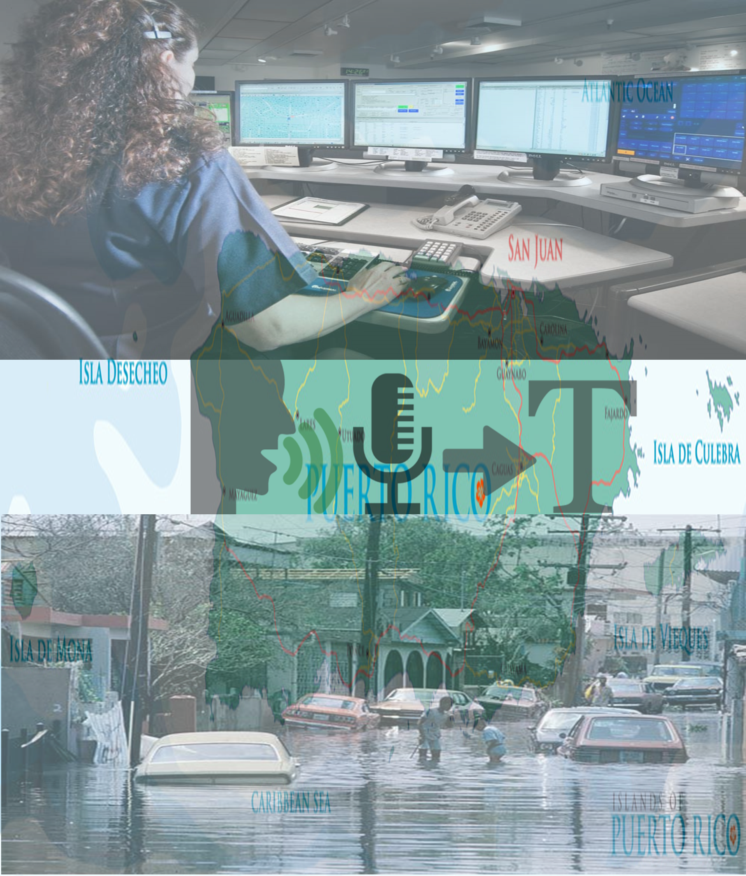
Code Patterns
Create a mobile written Hangul translation app
Analyze Twitter handles and hashtags for sentiment and content
Deploy a serverless multilingual conference room
Create an app to perform intelligent searches on data
Translate
voice and written communications on the fly to improve information sharing
developer.ibm.com/callforcode/resources/translate/

Slide 13

Code Patterns
Classify ICD-10 data with Watson
Develop a web-based mobile health app that uses machine learning
Create and deploy a scoring model to predict heart rate failure
Create visualizations to understand food insecurity
Analyze open medical datasets to gain insights
Understand, analyze, and predict healthcare and nutrition needs to improve basic services
developer.ibm.com/callforcode/resources/healthcare/

Slide 14
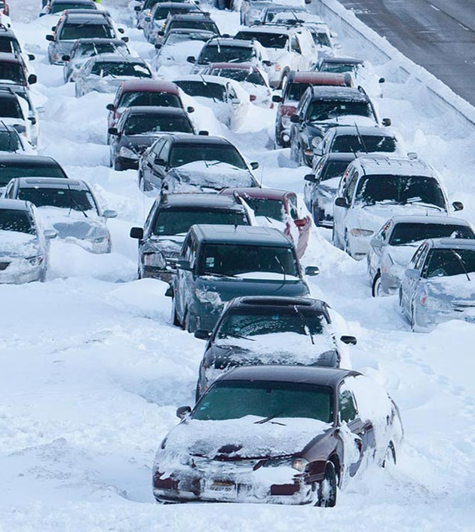
Code Patterns
Build a cognitive recommendation app with Swift
Correlate flight and weather data in an augmented reality mobile app
Create charts, graphs, and maps using open city datasets
Create a simple chatbot with Node.js and Watson Assistant
Improve logistics based on traffic and weather activity to reduce number of people affected
developer.ibm.com/callforcode/resources/traffic-and-weather/

Slide 15
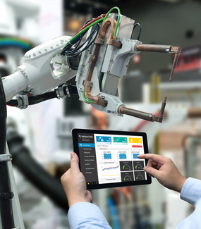
Code Patterns
Analyze industrial equipment for defects
Detect voltage anomalies in household IoT devices
Develop an IoT asset tracking app using Blockchain
Analyze device sensor data to take corrective or preventative action automatically
developer.ibm.com/callforcode/resources/preventative-action/

Slide 16
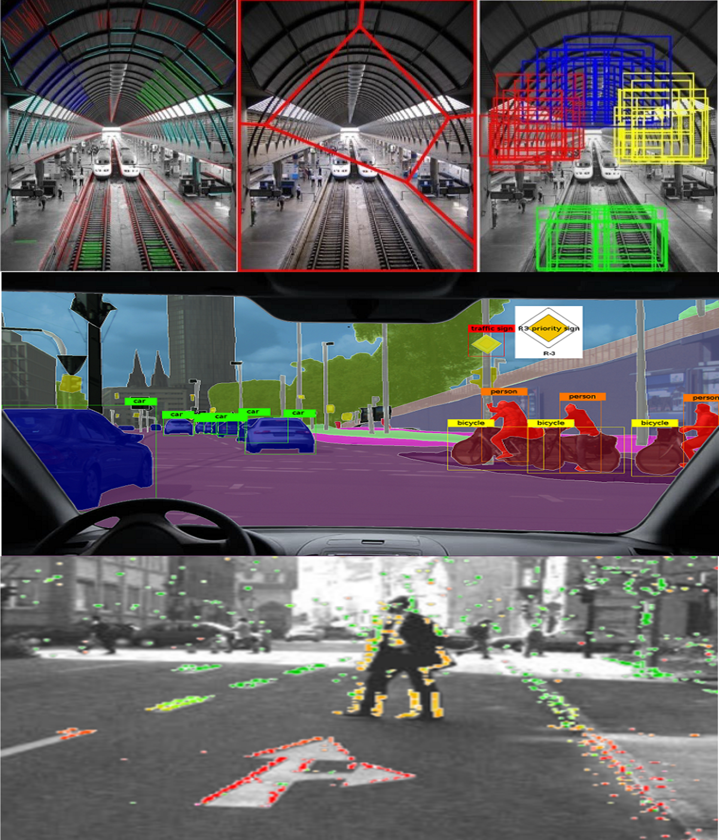
Code Patterns
Build an iOS game powered by Core ML and Watson Visual Recognition
Locate and count items in an image with object detection
Classify vehicle damage images
Use visual recognition to process claims quickly or identify immediate need for aid
developer.ibm.com/callforcode/resources/visual-recognition/
Notes:
Apply cognitive to classify and tag mobile images on the go
Build a web-based blockchain insurance application
Locate and count items in an image with object detection (Uses Power AI, that's OK)
Classify vehicle damage images
Analyze an image and send a status alert (Needs fix - https://github.com/IBM/image-analysis-iot-alert/issues/9 appears to be an API usage problem, maybe Watson Vision changed, waiting on maintainer response)

Slide 17
REGISTRATION

Slide 18
Technology Outlook – Cloud , AI and IoT Services

Slide 19

IBM Cloud has IaaS / PaaS services in ONE Cloud Platform
Industry
IoT
Block Chain
Health
Financial
Services
Media
Discovery
Conver-sation
Natural Language
Speech & Vision
Tradeoff Analytics
Retrieve & Rank
Cognitive
Data & Analytics
Database
Data
Data Management
Analytics
Visualize
Messaging
Mobile
App Security
API & Integration
DevOps
Developer Tools
Containers
Cloud Foundry
Event-Driven
Run-Times
Compute
Storage
Network
Infrastructure
Virtual Servers
Bare Metal
VMware
Block
Object
File
Public
Private
VPN
CDN
Public
Dedicated
Local
Multi-Tenant
Single-Tenant
Single-Tenant
IBM Cloud
Client
Notes:
IBM Cloud has cloud services that span IaaS and PaaS
From Infrastructure right up to Industry cloud solutions
Through IBM Cloud, users are able to choose the level at which they wish to operate
They can do it themselves at the infrastructure level (IaaS)
They can let IBM manage the infrastructure and concentrate on DevOps at the PaaS level
Or they can leverage both IaaS and PaaS in any combination they wish
E.g. A workload might run in a VSI or a Bare Metal service but the user may wish to leverage DBaaS instead of managing the database themselves

Slide 20
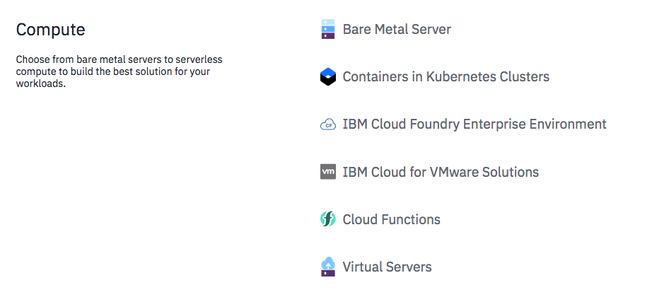
Choose Compute

Slide 21
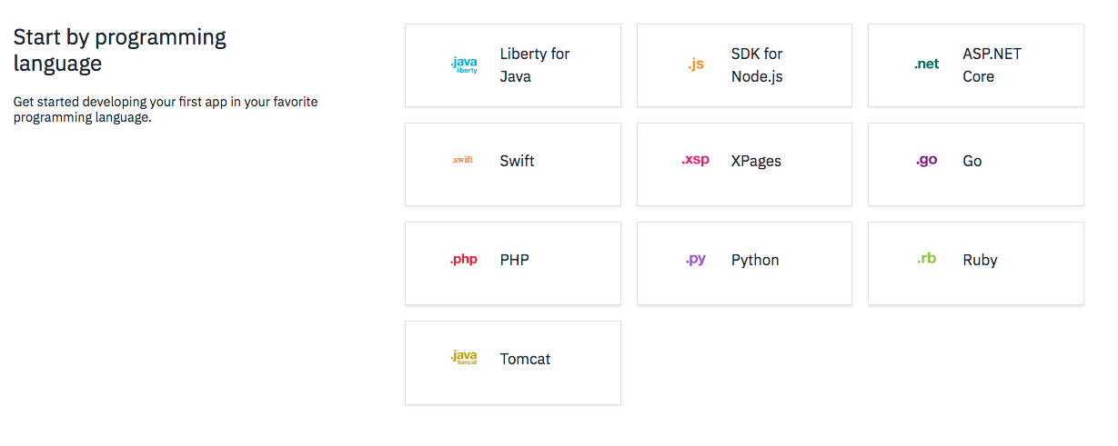
Choose Programming Language

Slide 22
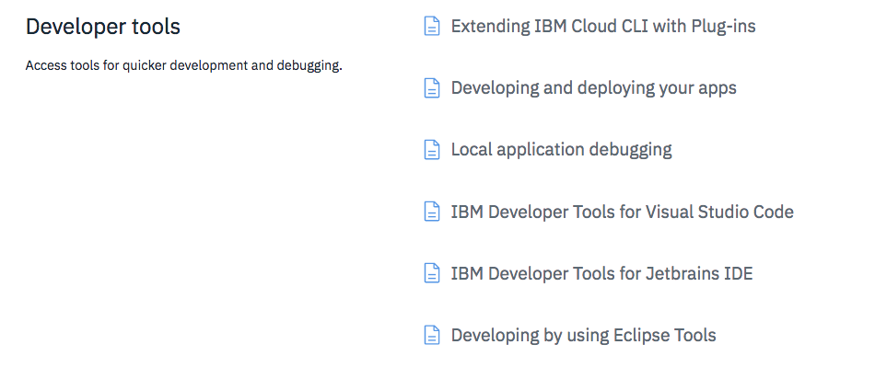

Slide 23
Watson Services
Assistant
SDKs and code samples at github.com/watson-developer-cloud
Notes:
IBM Watson analyzes natural language in text and audio, and images, to extract value that can be used in applications across all industries. For example, a customer service chatbot could listen to a user speak, transcribe the audio with Speech to Text, process the text using Conversation to understand the intents and entities and determine a response, and then speak back the response using Text to Speech. We can also understand the personality of our user with the help of Personality Insights, and emotions using Tone Analyzer / Natural Language Understanding.

Slide 24
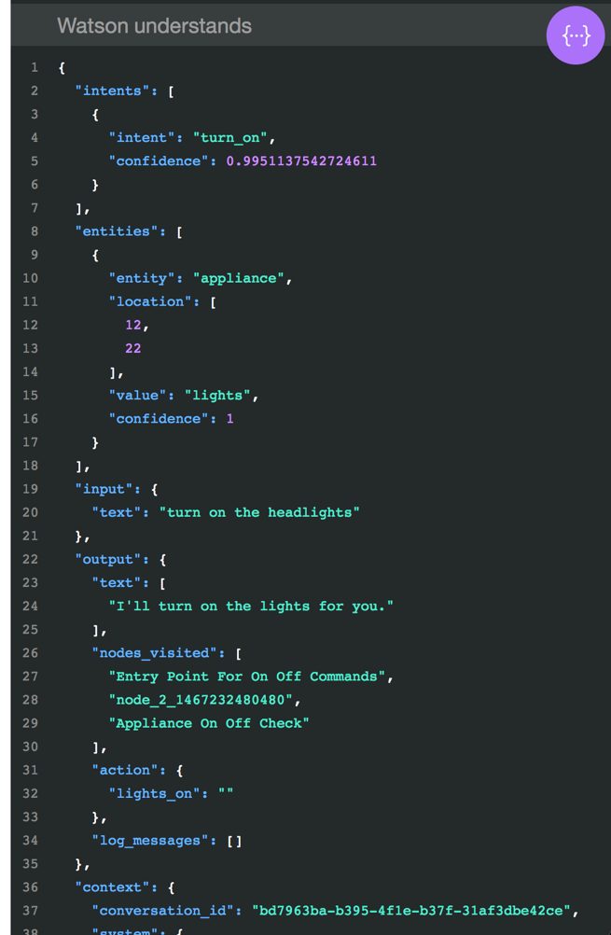
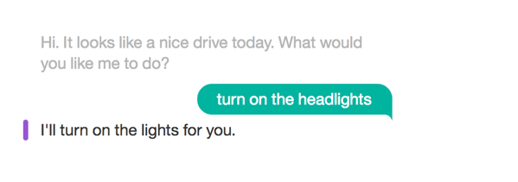

Watson Assistant
Quickly build and deploy chatbots and virtual agents across a variety of channels, including mobile devices, messaging platforms, and even robots.
ibm.biz/demo-assistant

Slide 25
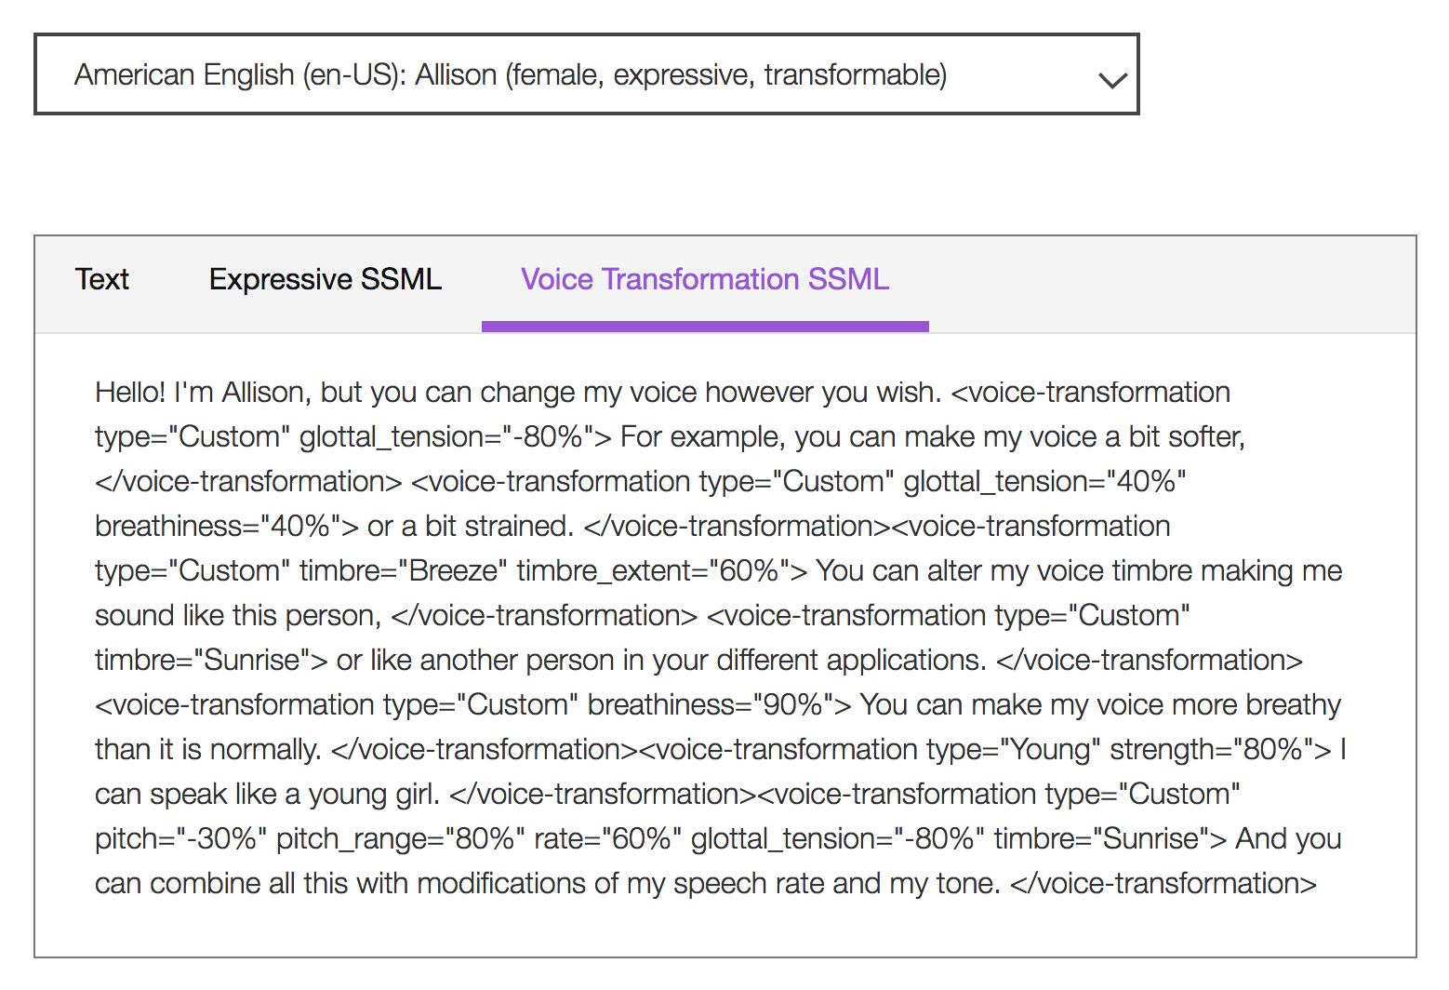
Text to Speech
Understand text and natural language to generate synthesized audio output complete with appropriate cadence and intonation. It is available in 13 voices across 7 languages.
ibm.biz/demo-text-to-speech

Slide 26
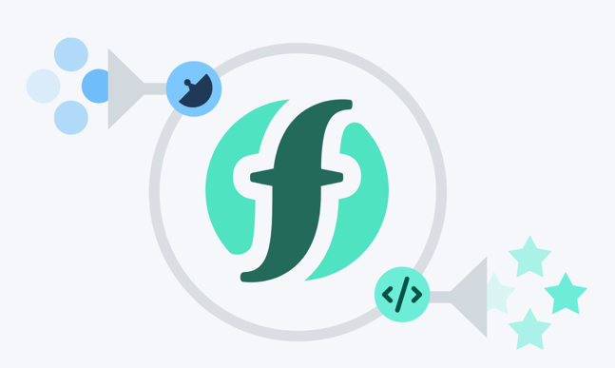
IBM Cloud compute services
Cloud Foundry runtimes
deploy app without managing infrastructure
Java, Node.js, Swift, ASP.NET Core, Python, PHP, Ruby, Go...
Cloud Functions "serverless"
trigger actions from events
or REST API calls
Notes:
IBM Watson analyzes natural language in text and audio, and images, to extract value that can be used in applications across all industries. For example, a customer service chatbot could listen to a user speak, transcribe the audio with Speech to Text, process the text using Conversation to understand the intents and entities and determine a response, and then speak back the response using Text to Speech. We can also understand the personality of our user with the help of Personality Insights, and emotions using Tone Analyzer / Natural Language Understanding.

Slide 27
IBM Cloud compute services
Kubernetes clusters
Run scalable container applications without managing infrastructure
Connect with over 170 IBM and third-party services
Cloud Infrastructure
Bare Metal and Virtual Servers with scalable, dedicated core and memory allocations
Storage and networking services you control
Notes:
IBM Watson analyzes natural language in text and audio, and images, to extract value that can be used in applications across all industries. For example, a customer service chatbot could listen to a user speak, transcribe the audio with Speech to Text, process the text using Conversation to understand the intents and entities and determine a response, and then speak back the response using Text to Speech. We can also understand the personality of our user with the help of Personality Insights, and emotions using Tone Analyzer / Natural Language Understanding.

Slide 28
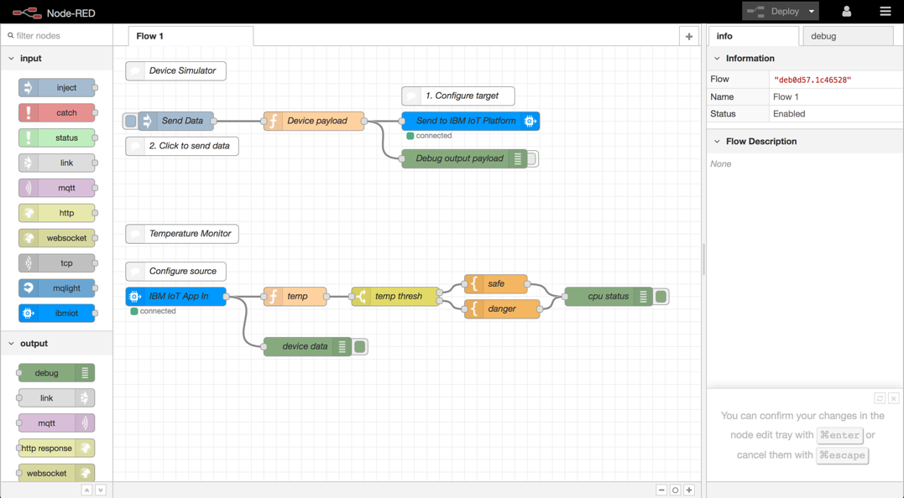


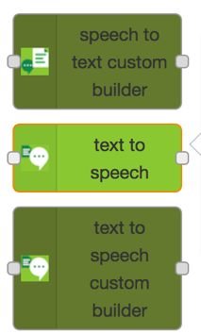
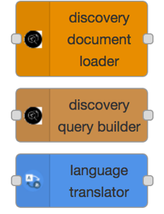
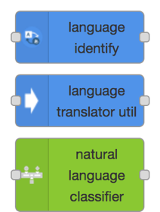
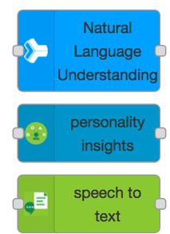
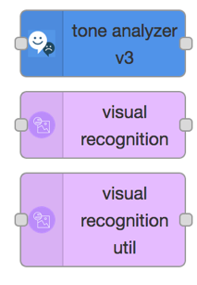
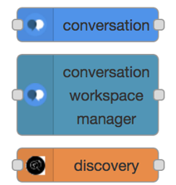
Watson IoT and Node-RED
Quickly build flow-based applications handling sensor events
IoT device input / output nodes
And Watson nodes

Slide 29
CODE PATTERN

Slide 30
Theme #1: “Build secure, resilient, traceable and transparent supply networks with blockchain”
CODE PATTERN: “Track donations with Blockchain”
Complete this pattern to build a simple three-member network using the IBM Blockchain Platform, on which cause-specific pledges and fund transfers are made by the government, registered with aid organizations, and validated by Global Citizen

Slide 31
Theme #2: “Use AI and bots to improve real-time communications with natural language processing”
CODE PATTERN: “Create an app to preform intelligent searches on data”
Develop a web app to extract and visualize enriched data using Node.js and Watson Discovery

Slide 32
Theme #3: “Understand, analyze and predict health and nutrition needs to improve services with data science”
CODE PATTERN: “Analyze open medical datasets to gain insights"
Use machine learning to predict U.S. opioid prescribers with Watson Studio and scikit-learn

Slide 33
Theme #4: ”Improve logistics based on traffic and weather activity to reduce the number of people affected”
CODE PATTERN: “Build a cognitive recommendation app with Swift “
Build a Swift-based mobile chatbot to provide recommendations, reservations, and event planning

Slide 34
Theme #5: ”Collect and analyze device sensor data to take corrective and preventative action automatically”
CODE PATTERN: “Use MQTT to stream real-time data “
Create a real-time stream of carbon intensity for the NY State power grid with MQTT and Kubernetes

Slide 35
Theme #6: ”Use machine learning, deep learning, and visual recognition to improve critical processes”
CODE PATTERN: “Classify vehicle damage images “
Create a custom visual recognition classifier with Apache Cordova, Node.js, and Watson Visual Recognition

Slide 36
CODE PATTERN DEMO

Slide 37
CODE PATTERN Hands On

Slide 38
Ideation

Slide 39
SUBMISSION AND JUDGING NOTES
Working code > Slides
Convey a user-centered story with your demonstration
Show how technologies work together
More tips in the Pitch Workshop!!!
Criteria | Points
Completeness and transferability | 5
Effectiveness and efficiency | 5
Design and usability | 5
Creativity and innovation | 5
Use of IBM and other Call for Code sponsor technology | 5
Idea
User Experience
Implementation

Slide 40
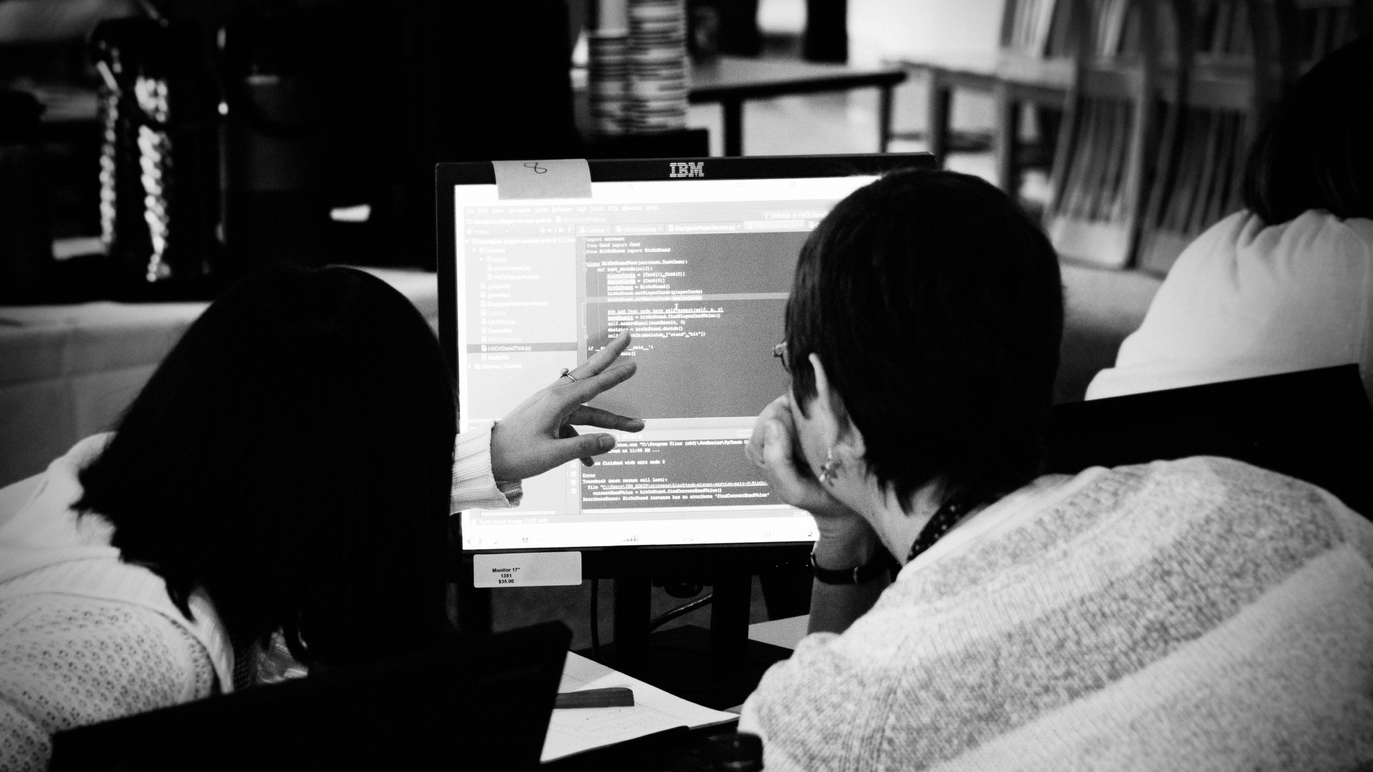
developer.ibm.com/callforcode

